Slide 1










Oct
10
The Universe
Describe the features of the universe
Identify and classify different types of galaxies
Workbook or laptop (for writing)
Pen
Name five objects that can be found in space.
Learning about the features of the universe
Applying understanding
Notes:
Font: Coconutz by typefactory on fontspace.com

Slide 2
Celestial Objects - Definitions
The Universe
The Universe is comprised of many features from galaxies, to black holes to planets.
MOON:
A natural satellite revolving around a planet
PLANET:
A celestial body, larger than a comet or asteroid, which revolves around a star
STAR:
A celestial body that generates light and other radiant energy and consists of a mass of gas held together by its own gravity
COMET:
A celestial body with a central mass and a tail of dust and gas, that orbits a star along an elongated course

Slide 3
Celestial Objects - Definitions
The Universe
SOLAR SYSTEM:
A system of planets or other bodies orbiting a star
GALAXY:
A system of millions or billions of stars, together with gas or dust, held together by gravitational attractions
LOCAL GROUP:
Portions of space where many galaxies are clustered
SUPER CLUSTER:
A large group of smaller galaxy clusters or galaxy groups

Slide 4
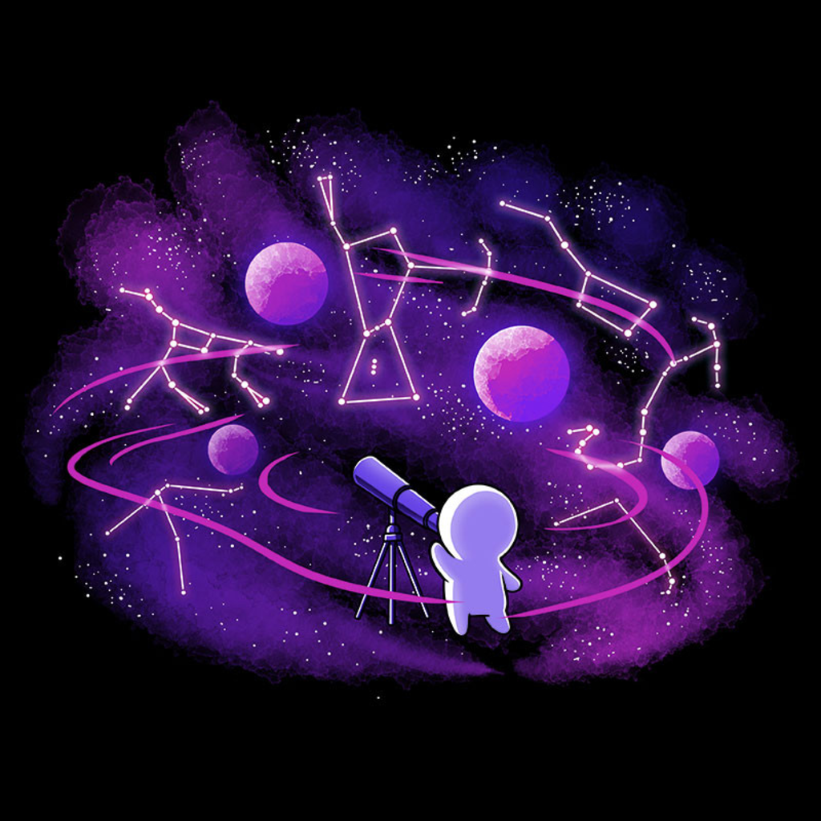
Celestial Objects - Definitions
The Universe
CONSTELLATION:
A group of stars forming a recognizable pattern that is traditionally named after its apparent form or identified with a mythical figure
BLACK HOLE:
A region of space having a gravitational field so intense that no matter or radiation can escape

Slide 5
Celestial Objects
The Universe
Order the below celestial bodies from largest to smallest:
Moon
Solar system
Galaxy
Universe
Star
Constellation
Planet
Universe
Galaxy
Constellation
Solar system
Sun
Planet
Moon

Slide 6
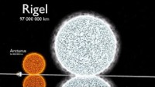
Space Perspective
The Universe

Slide 7
The Universe
The Universe
Write out and complete the following sentences
We live on ______________.
Our planet orbits in the Sun in the __________ ___________.
The Milky Way is our ________________.
A group of galaxies pulled together by gravity are called a _____________ ______________.
___________________ are considered to be the largest feature of the universe

Slide 8
The Universe
The Universe
Write out and complete the following sentences
We live on Earth.
Our planet orbits in the Sun in the Solar System.
The Milky Way is our galaxy.
A group of galaxies pulled together by gravity are called a local group.
Super clusters are considered to be the largest feature of the universe

Slide 9
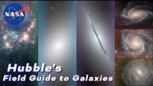
The Universe
The Universe

Slide 10
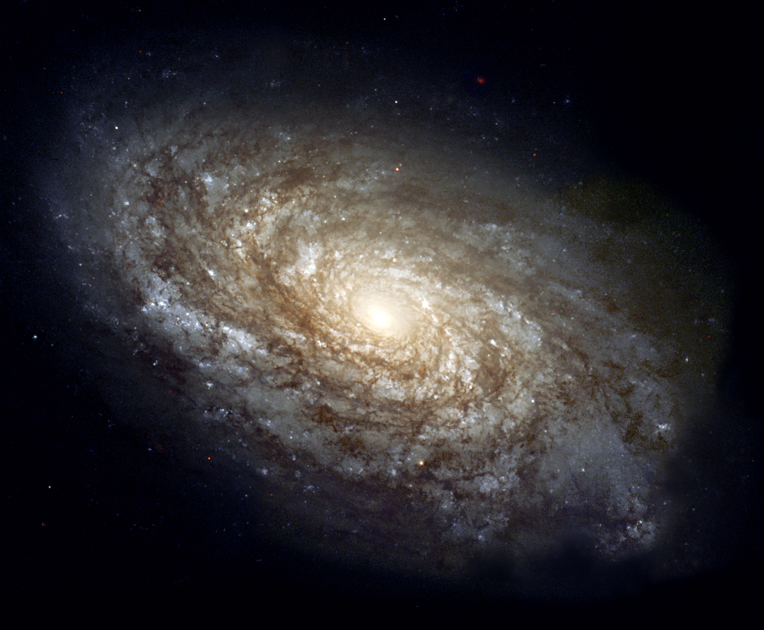
Galaxies
The Universe
Galaxies can be classified into four major types:
Spiral
Barred spiral
Elliptical
Irregular

Slide 11
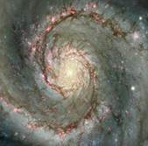
Spiral Galaxies
The Universe
Spiral galaxies are made up of:
A flattened disk containing a spiral and pin-wheel shaped arms.
A bulge at the center, and
A halo
Spiral galaxies vary in size and shape and are classified according to their size, shape, bulge and appearance of arms

Slide 12
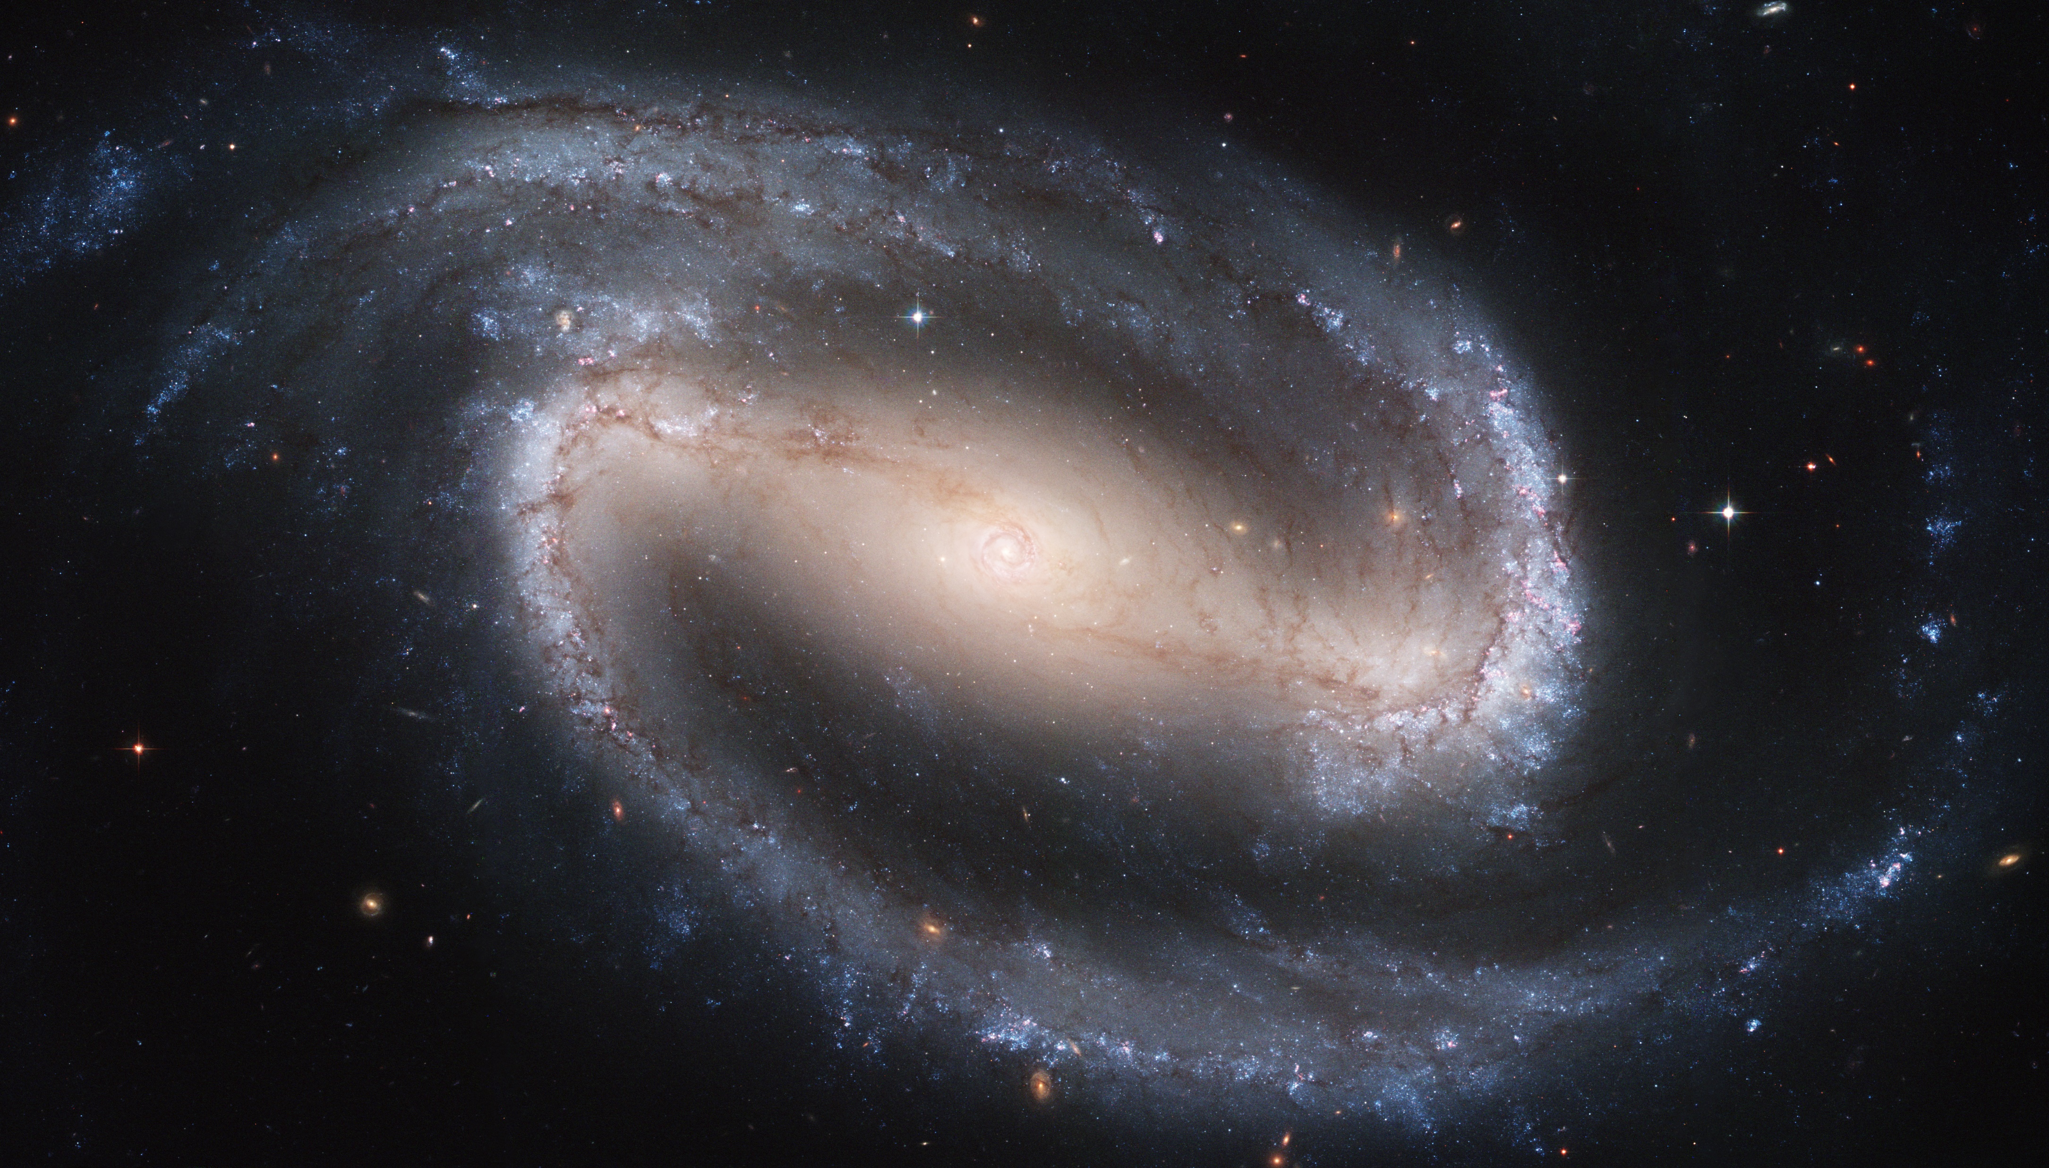
Barred Spiral Galaxies
The Universe
Barred spiral galaxies are spirals that have a bar running across the center of the galaxy

Slide 13
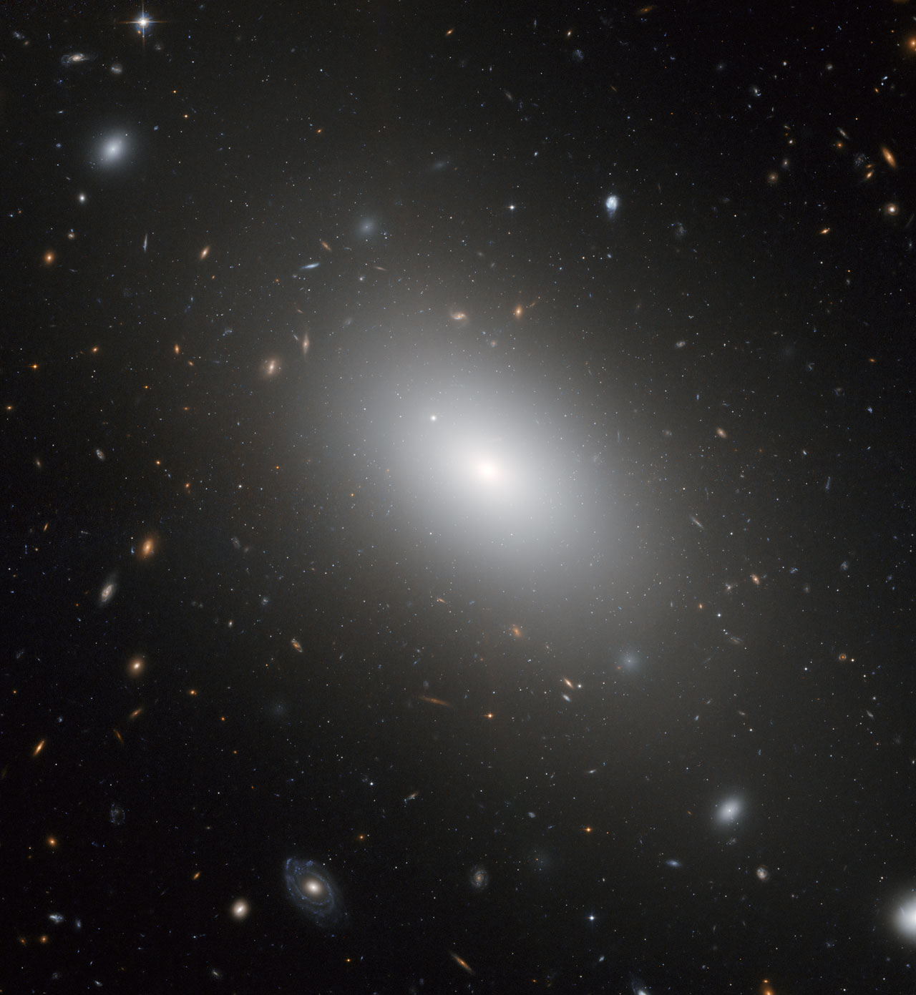
Elliptical Galaxies
The Universe
Elliptical galaxies
Do not have a disc or arms
Are characterized by a smooth, ball-shaped appearance
They contain old stars and possess little gas or dust. They are classified by the shape of the ball, which can range from round to oval.

Slide 14
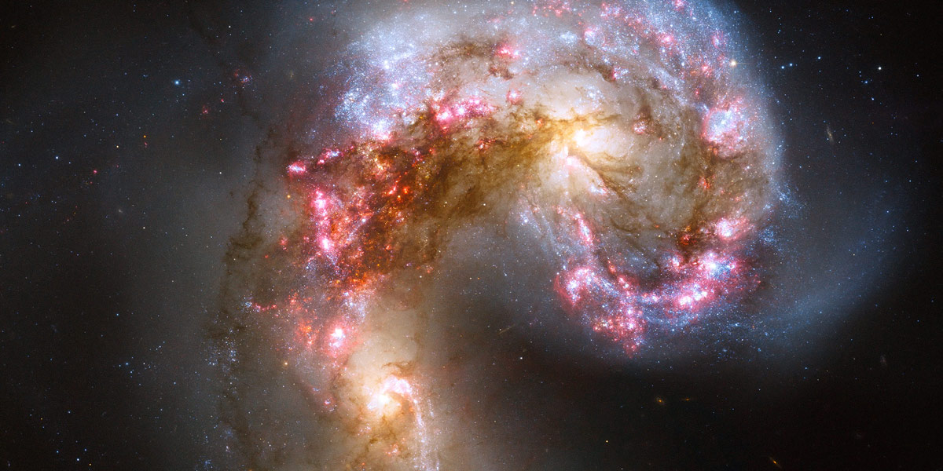
Irregular Galaxies
The Universe
Irregular Galaxies are galaxies that are neither spiral or elliptical. They tend to be smaller objects without definite shape and tend to have very hot newer stars mixed with lots of dust and gas.

Slide 15

EXIT TICKET
The Universe
Please complete the exit ticket provided!
Notes:
Exit ticket ppt – slide 7

Slide 16



Oct
10
The Universe
Describe the features of the universe
Identify and classify different types of galaxies
Notes:
Font: Coconutz by typefactory on fontspace.com

Slide 17
* BRAIN BREAK *
Touch your left ear with your right hand.
Now take a deep breath and close your eyes.
On each count, take a deep breath in, and release.
Now, touch your nose with your left hand
Now switch… right ear and left hand, nose with right hand
And switch… left ear and right hand, nose with left hand
Notes:
Get students to complete brain break exercise then do a deep cleansing breath to release and resettle.
Instruct students to take a deep breath and close their eyes.
Slowly count down from 5 and tell students to take a deep breath on each count.
At 1, tell students to open their eyes and resume the lesson.

Slide 18
GAME RULES
1. Only the selected person on the team can answer the question (no help!)
2. If you get the answer right you get to attack! Get it wrong, another team gets a go.
3. Once you’ve been attacked 5 times, that team can’t win (but you can still attack others).
4. Last team standing wins!

Slide 19
Put your books away
Collect a whiteboard, marker & cloth
New Rule:
Each correct answer gets a point… top 3 most points get lollies!
Get your brain ready…
It’s time to test your knowledge!

Slide 20



June
08
Classroom expectations
Identify and understand class expectations
Workbook or laptop (for writing)
Pen
Does a ball dropped from 10m have the same amount of potential energy as a ball dropped from 50m?
Yes or no?
Why?
Go through the class rules
Identify class behaviour and responsibilities
Go through “start of lesson” expectations
Set up science notebook
Notes:
Font: Coconutz by typefactory on fontspace.com

